Slide 1
MILESTONE 3 • 3 MARKS
DESIGN MUST CONNECT
Project Design
Presentation
01
Requirements
02
Architecture
JAVA DESKTOP APPLICATION
03
Classes + Data
Swing UI • JDBC • MySQL
04
Screens + Interactions
PROJECT TITLE
Exam Seat Arrangement System
(Smart Exam Seating Arrangement System)
Every design element traces back to an approved requirement (FR-01 to FR-08).
Team No.: 8 | Class/Semester: S3 | Course: Java Programming
Review Date: 30 / 10 / 2026
Notes:
Introduce the project: a Java Swing + JDBC + MySQL desktop application that generates clash-free exam seating plans. Team 8, S3, Java Programming.

Slide 2
MANDATORY EVIDENCE
Team and HackerRank Java progress
Milestone 2 Java stars compared with the stars visible on the current review date
# | Student name | Roll no. | Role | Profile / username | M2 Java stars | Current Java stars | Change
1 | Antony Zavior K | 62 | Team Lead | hackerrank.com/profile/haxey61790 | 5 | 5 | 0
2 | Lijo P Thomas | 67 | Member | hackerrank.com/profile/lijot707 | 5 | 5 | 0
3 | Milind Krishnan | 69 | Member | Add profile link / screenshot | — | — | —
Antony Zavior K
Lijo P Thomas
Milind Krishnan
Maintained 5 stars (M2 → current). Leads seat allocation and exam modules.
Maintained 5 stars (M2 → current). Leads login, users and student modules.
Profile link and star level to be added and re-checked on the review date.
Working profile link or current screenshot for every member. This table continues in Code Review 1 and later.
REQUIRED
Notes:
Three team members. Antony and Lijo are at 5 stars, unchanged since Milestone 2. Milind's profile link and star count must be added and verified on the review date.

Slide 3
01 • DESIGN BASIS
Approved scope and design changes
Milestone 2 requirements baseline; every change recorded explicitly
ID | FR | Change and reason | Status
DC-01 | FR-03 | CSV import not implemented; students entered on the Student screen. Moved to future enhancements. | Pending faculty
DC-02 | FR-06 | Room chart is read-only; manual seat swap is future work. Regenerate with another shuffle instead. | Pending faculty
DC-03 | FR-02 | Rooms use rows × columns (capacity = rows × columns); no seats-per-bench field. | Pending faculty
DC-04 | FR-05 | Same-branch separation via Department Mixing (round-robin) plus eight other shuffle options. | Pending faculty
DC-05 | FR-01 | Passwords stored as plain text for now; hashing is a future enhancement. | Pending faculty
APPROVED DESIGN SCOPE
Exam coordinator generates clash-free seating plans
Modules: Login, Master data, Allocation, Search & Reports
Outputs: room charts, seat search, attendance sheets, printable reports
Baseline: Java, Swing, JDBC, MySQL
DESIGN OBJECTIVE
Layered MVC design: Swing screens, services, DAOs with JDBC; no SQL in the UI.
If a requirement changes, update the Requirements Document, Design Document and PPT together.
RULE
Notes:
Five design changes DC-01 to DC-05 against the Milestone 2 baseline. All are currently pending faculty approval; unapproved additions are listed as future enhancements.

Slide 4
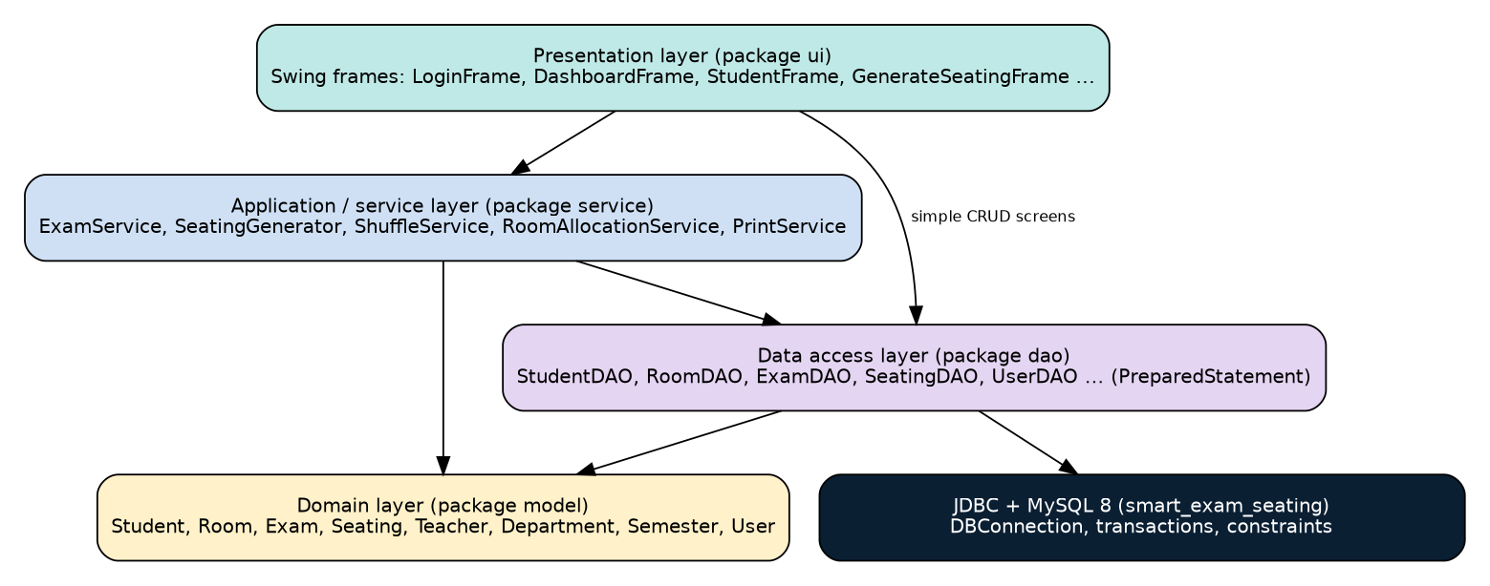
02 • ARCHITECTURE
Layered desktop application design
Swing event handling, application logic, domain behaviour and JDBC persistence kept separate
ARCHITECTURE RULES
UI classes contain no SQL
DAO classes never control Swing components
Service layer coordinates use cases
PreparedStatement for all parameterised SQL
Transactions protect multi-step updates (seating save)
try-with-resources closes connections and result sets
Layer | Key classes (package) | Depends on
Presentation | ui: LoginFrame, DashboardFrame, StudentFrame, GenerateSeatingFrame | Service, DAO, model
Service | service: ExamService, SeatingGenerator, ShuffleService, PrintService | DAO, model
Domain | model: Student, Room, Exam, Seating, Teacher, User | None
Data access | dao: StudentDAO, RoomDAO, ExamDAO, SeatingDAO, UserDAO | JDBC, MySQL
Notes:
Figure 1 from the design document. Arrows show permitted dependencies only: ui to service/dao/model, service to dao/model, dao to JDBC and MySQL.

Slide 5
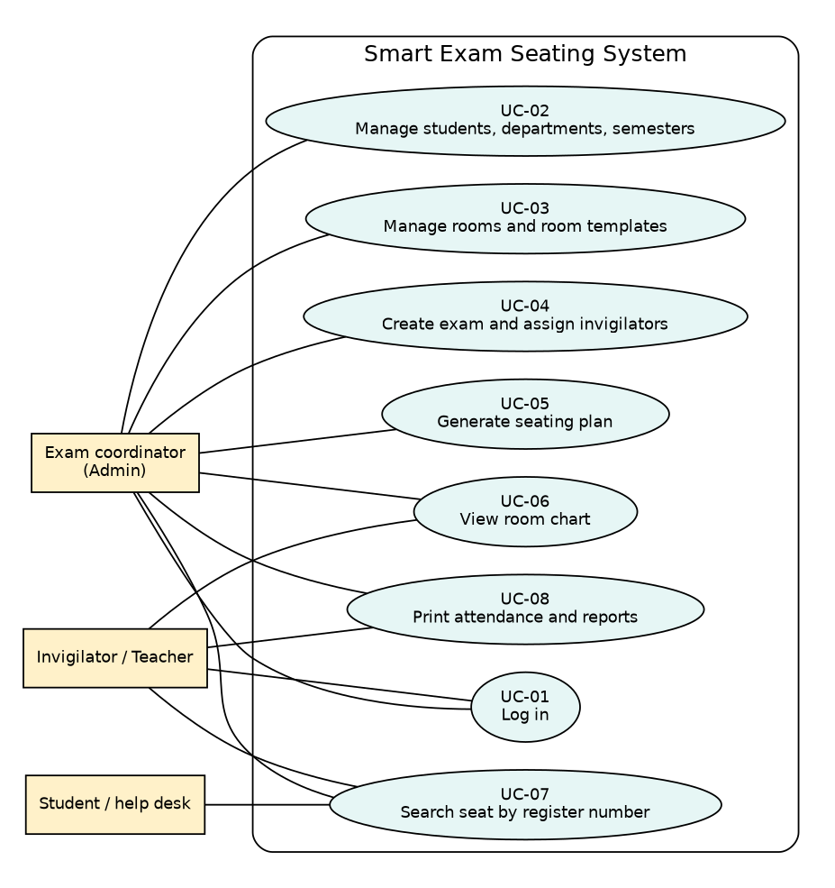
03 • USE CASES
Actors and system behaviour
Every functional requirement (FR-01 to FR-08) appears in at least one use case
Use case | Actor | Purpose | FRs
UC-01 Log in | All users | Authenticate, open dashboard | FR-01
UC-02 Manage students | Admin | Add, update, delete, search | FR-03
UC-03 Manage rooms | Admin | Rooms (rows × columns), templates | FR-02
UC-04 Create exam | Admin | Exam, departments, invigilators | FR-04
UC-05 Generate seating | Admin | Shuffle, assign room/row/seat | FR-04–06
UC-06 View room chart | Admin, Teacher | See seating chart per room | FR-06
UC-07 Search seat | Student, staff | Find seat by register number | FR-07
UC-08 Attendance, reports | Admin, Teacher | Print sheets and reports | FR-08
Actors: Exam coordinator (Admin) • Invigilator / Teacher • Student / help desk
Detailed specifications: UC-05 Generate seating plan and UC-07 Search seat.
Notes:
UC-05 (generate): admin picks exam, shuffle and rooms; system loads students, shuffles, assigns room/row/column and saves in one transaction. Alternate flows: no students, capacity too low (warning), plan exists (confirm), DB error (rollback). UC-07 (search): enter register number, validate, query seating, show room/row/seat; read-only.

Slide 6
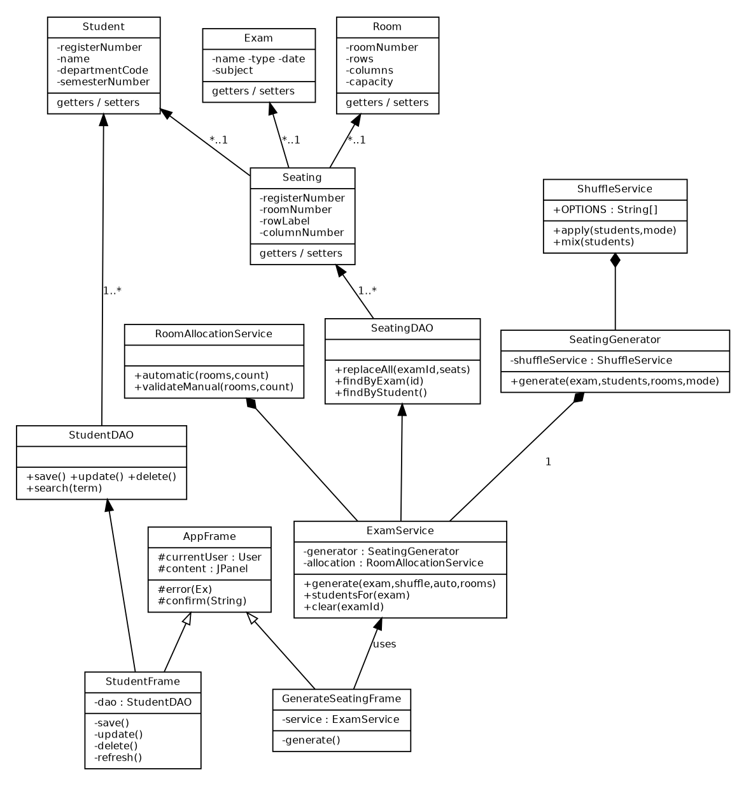
04 • OBJECT DESIGN
Classes, responsibilities and packages
Clear object-oriented decomposition and separation of concerns
Class | Type | Responsibility | FRs
AppFrame | UI (abstract) | Base screen: current user, error()/confirm() | FR-01
GenerateSeatingFrame | UI | Collects exam, shuffle, rooms; starts generation | FR-05
ExamService | Service | Coordinates student/room selection and saving | FR-05
SeatingGenerator | Service | Assigns shuffled students to room, row, column | FR-05
ShuffleService | Service | Applies shuffle option incl. Department Mixing | FR-05
SeatingDAO | DAO | Transactional save; queries by exam/room/student | FR-05–07
Student, Room, Exam, Seating | Model | Plain data classes, private fields, getters/setters | FR-02–07
PACKAGE PLAN
com.smartseating.ui • service • model • dao • util
Inheritance: screens extend AppFrame. Composition: ExamService owns DAOs and generators.
Notes:
Encapsulation via private fields and getters/setters; inheritance via abstract AppFrame; polymorphism in ShuffleService.apply() choosing ordering by option; composition: ExamService owns SeatingGenerator and RoomAllocationService, SeatingGenerator owns ShuffleService.

Slide 7
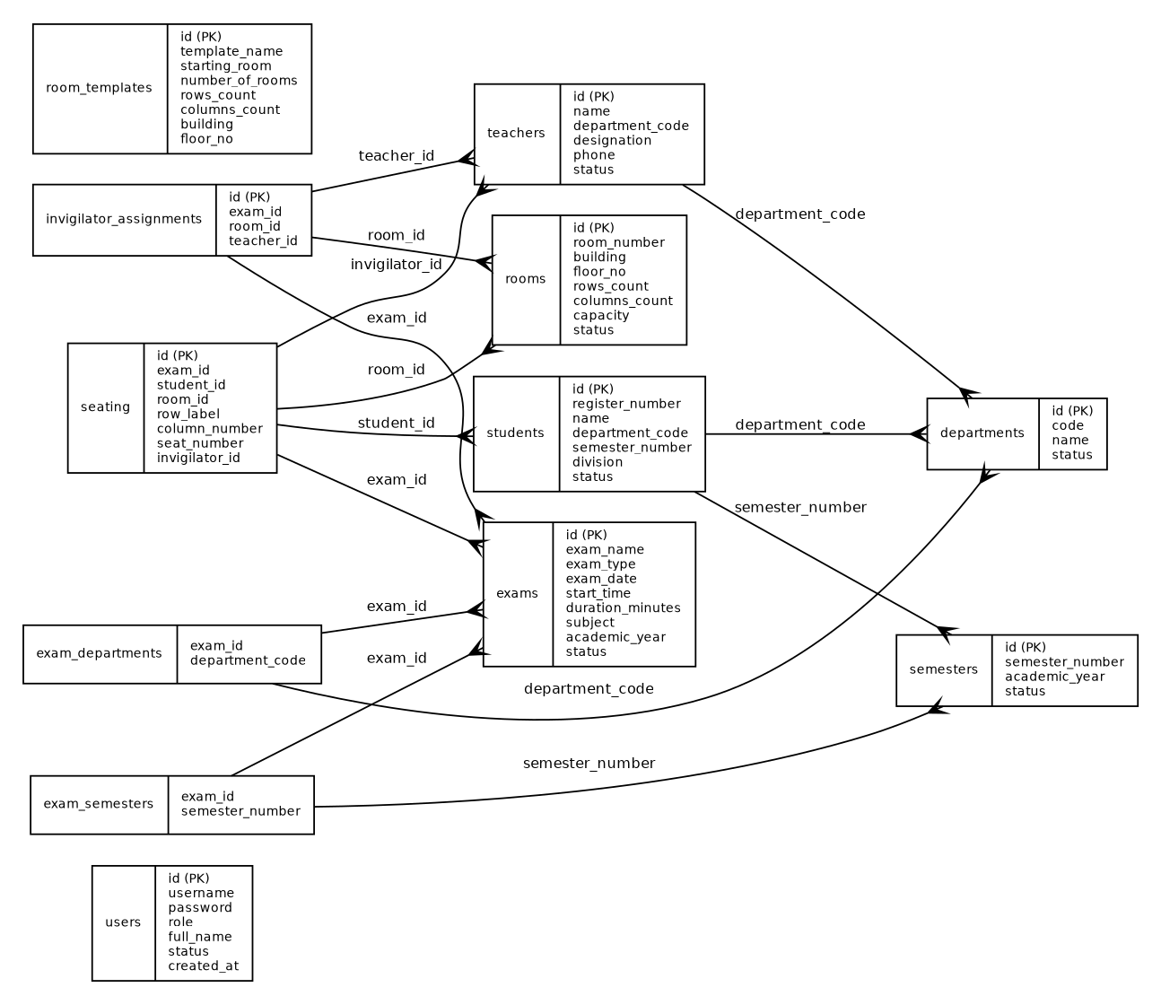
05 • DATABASE
Entities, relationships and constraints
12 tables support FR-01 to FR-08 without duplication
Table | Purpose | Key / FK | FRs
users | Logins and roles | PK id | FR-01
departments, semesters | Master data | PK id | FR-03
students | Student records | FK dept, semester | FR-03
rooms, room_templates | Rows × columns layout | PK id | FR-02
teachers, invigilator_assignments | Invigilators and room duty | FK dept, exam, room | FR-04
exams (+ 2 link tables) | Exam sessions and scope | Composite PK, FK exam | FR-04
seating | Seat per student per exam | FK exam, student, room | FR-05–08
DATABASE
KEY CONSTRAINTS
MySQL 8
schema: smart_exam_seating
UNIQUE (exam, student) and (exam, room, row, column); CHECK capacity = rows × columns
Notes:
Figure 5 ER diagram generated from schema.sql. JDBC design: PreparedStatement everywhere, try-with-resources, and a transaction in SeatingDAO.replaceAll().

Slide 8
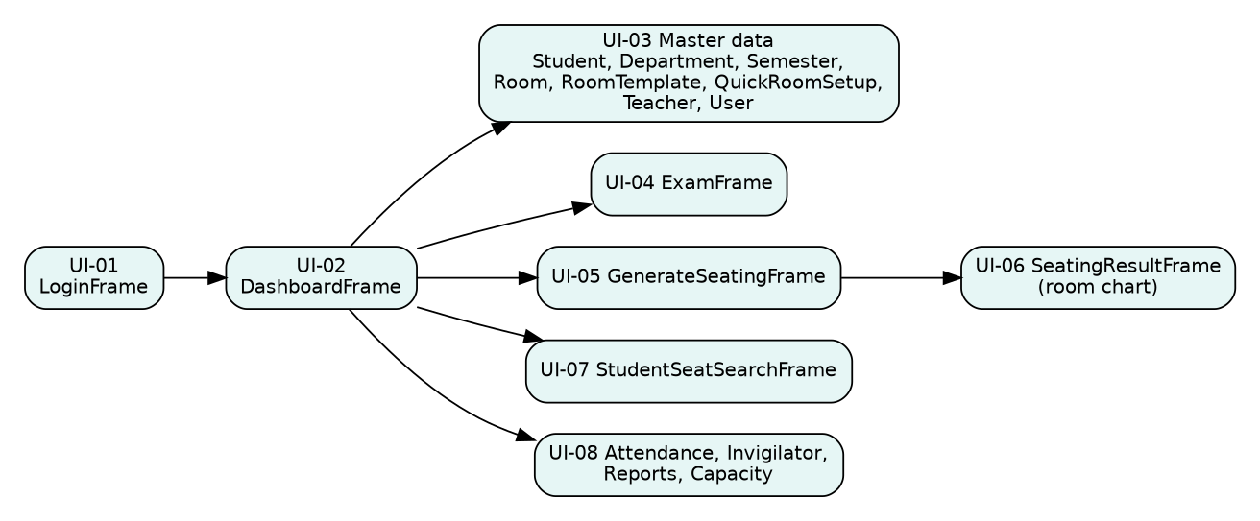
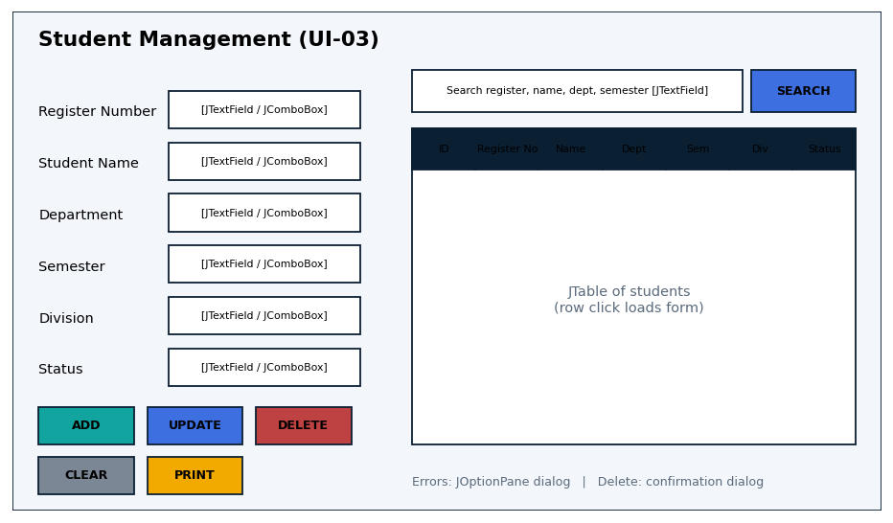
06 • SWING UI
Screen navigation and interface design
Each screen supports a defined use case with validation and user feedback
NAVIGATION MAP
WIREFRAME: UI-03 STUDENT SCREEN (FR-03)
Validation
Confirmation
Empty state
Roles
JOptionPane names the field, e.g. “Register number is required.”
Delete and regenerate ask first
Search with no match shows “not found”
Teacher accounts: Add/Update/Delete disabled
SCREEN REVIEW
Each screen: actor, use case, inputs (JTextField, JComboBox), actions, JTable results, error/confirm dialogs, FR IDs. One JFrame per function.
Notes:
UI-01 Login, UI-02 Dashboard, UI-03 Master data (students, departments, semesters, rooms, teachers, users), UI-04 Exam, UI-05 Generate Seating, UI-06 Seating Result, UI-07 Student Seat Search, UI-08 Attendance/Invigilator/Reports.

Slide 9
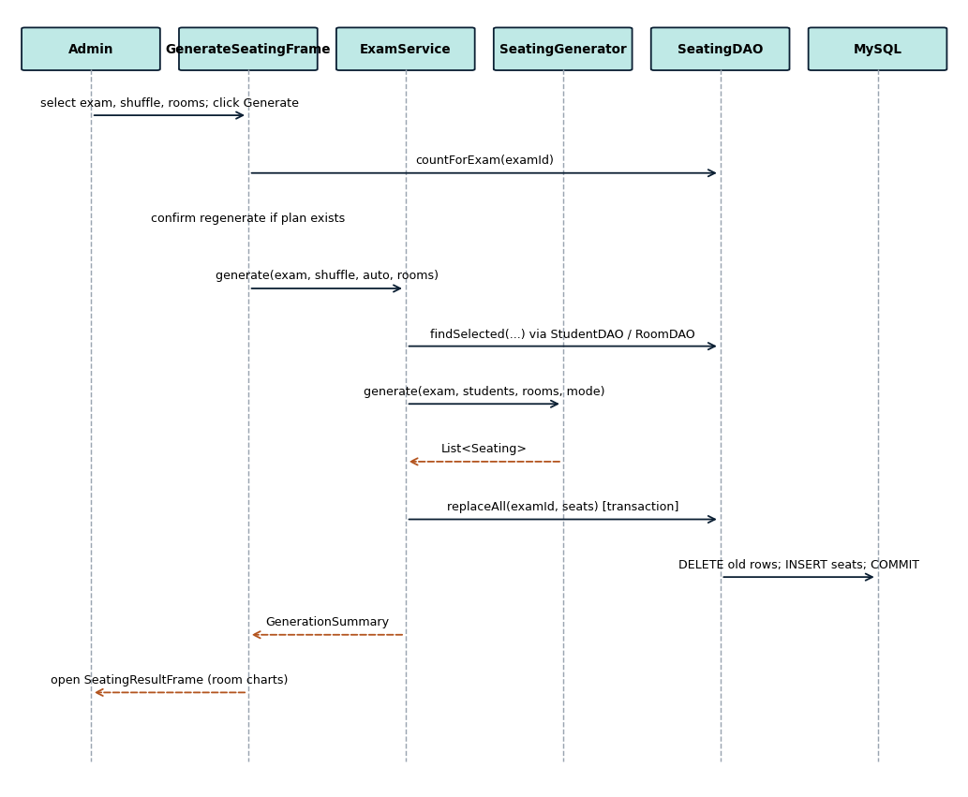
07 • INTERACTION DESIGN
Sequence: UC-05 Generate seating plan
One write workflow travels from Swing to MySQL in a single transaction
1
Admin selects exam, shuffle and room mode; clicks Generate
2
GenerateSeatingFrame checks for an existing plan and asks to confirm
3
ExamService loads matching students and rooms, SeatingGenerator shuffles and assigns
4
SeatingDAO.replaceAll() deletes old seats, inserts new ones, commits
5
Result screen opens with room charts
On any SQL error the transaction is rolled back and a message dialog is shown.
Notes:
UC-05 path: GenerateSeatingFrame to ExamService.generate() to SeatingGenerator/ShuffleService to SeatingDAO.replaceAll() to MySQL. Related FR-04, FR-05, FR-06.

Slide 10
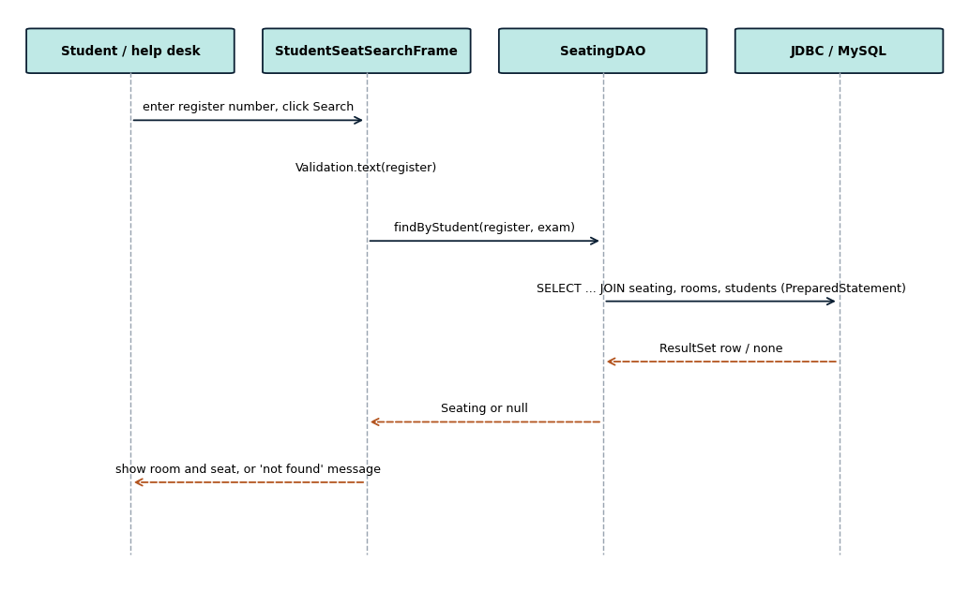
07 • INTERACTION DESIGN
Sequence: UC-07 Search seat
A read-only lookup by register number, with validation and a not-found state
1
User enters register number and clicks Search
2
StudentSeatSearchFrame validates input (not empty)
3
SeatingDAO.findByStudent() runs a JOIN query via PreparedStatement
4
Room, row and seat are shown, or a “not found” message
No data is changed. Result can be printed (FR-07, FR-08).
Notes:
UC-07 path: StudentSeatSearchFrame, validation, SeatingDAO.findByStudent(), JDBC/MySQL. Alternate flows: empty input shows a validation message; no seat found shows a not-found message; database error shows a message dialog.

Slide 11
07 • INTERACTION DESIGN
Validation, failure handling and data integrity
How bad input and failures are caught without losing data
SEQUENCE FOR UC-05
01 Actor
02 Swing UI
03 Service
04 DAO + JDBC
05 Database
Select exam, shuffle; Generate
→
GenerateSeatingFrame event
→
ExamService validates, shuffles
→
SeatingDAO prepared SQL
→
MySQL commit / result
VALIDATION
EXCEPTION HANDLING
DATA INTEGRITY
Required text not empty
Rows, columns, duration: positive whole numbers
Date yyyy-MM-dd, time HH:mm
Capacity ≥ students (service)
Unique register / room number (DB)
Invalid input: dialog, data kept
DB down: “Database connection failed”
SQL failure: rollback, resources closed
Unexpected error: generic dialog, no crash
PK, FK, UNIQUE, CHECK in schema.sql
No double-booked seat or student
PreparedStatement for all values
DB credentials from environment variables
Known limitation (DC-05): passwords are stored as plain text; SHA-256 hashing is planned.
Notes:
Known limitation DC-05: passwords are stored as plain text; SHA-256 hashing is planned.

Slide 12
REVIEW SUMMARY
Design traceability and readiness
The design is complete enough to begin Code Review 1 implementation
FR | Use case | Module / class | Screen | DB table | Test
FR-01 | UC-01 | LoginFrame, UserDAO | UI-01 | users | TC-01, 02
FR-02 | UC-03 | RoomFrame, RoomDAO | UI-03 | rooms, room_templates | TC-03, 04
FR-03 | UC-02 | StudentFrame, StudentDAO | UI-03 | students | TC-05, 06
FR-04 | UC-04 | ExamFrame, ExamDAO | UI-04 | exams, invigilator_assignments | TC-07
FR-05 | UC-05 | ExamService, SeatingGenerator, ShuffleService | UI-05 | seating | TC-08–10
FR-06 | UC-06 | SeatingResultFrame | UI-06 | seating | TC-11
FR-07 | UC-07 | StudentSeatSearchFrame, SeatingDAO | UI-07 | seating | TC-12, 13
FR-08 | UC-08 | AttendanceFrame, ReportsFrame, PrintService | UI-08 | seating | TC-14, 15
IMPLEMENTATION READINESS
DECISION REQUIRED
NEXT MILESTONE
Antony: seat allocation, exams, final review
Lijo: login, users, students, DB setup
Milind: rooms, search, reports, test data
Approved / Revise
Code Review 1
Basic Java + OOP, coding standards. Carry forward the HackerRank table.
Reviewer to mark
Notes:
Every FR maps to a use case, class, screen, table and planned test case. Team Lead: Antony Zavior K. Date: 30/10/2026.

